Slide 1


POTENTIALS OF
FOR DATA LINKAGE
Radmila Velichkovich
MA Survey Methodology and Public Opinion
MS Statistics
University of Neuchatel, Switzerland
SatRday conference, Belgrade, Serbia
27/10/2018

Slide 2
CONTENTS
Data linkage: What it is and why is it important?
Approaches in data linkage
How can R help?
Examples

Slide 3
Data linkage: What it is and why is it important?
What is data linkage?
-merging that brings together information from two or more sources of data
Why is it important?
-avoidance of new data collection
-cost-effective way of additional information
-linked data allow analysis not possible on individual datasets
-bunch of data ready to be exploit exists: in private/public sector/official statistics/health records/financial records/loyalty data/social media data/
-novel approaches preserve privacy
1) Pre-merge data cleaning
2) Applying data linkage framework
3) evaluating data linkage
Notes:
Example: LEHD; Longitudinal Employer Household Dynamics

Slide 4
Approaches in data linkage
Deterministic approach
exact agreement on a unique identifier(s)
Only id
alternative identifiers--such as SSNs, birth dates, and first and last names of individuals (provided it is reliable)
Probabilistic approach
Connecting datasets without unique identifier(s)
-based on partial information existing in the dataset
-based on some similarities
-connecting two datasets with different units of observation
Notes:
https://www.ncbi.nlm.nih.gov/pmc/articles/PMC5005943/

Slide 5

How can R help?
Functions in R merge() match() ___join() in dplyr Blocking and Soundex algorithm (English/German) in RecordLinkage package User-defined function | Packages in R RecordLinkage fastLink PPRL (Privacy Preserving Record Linkage)
DETERMINISTIC PROBABILISTIC
To be updated very soon
Notes:
https://www.gov.scot/resource/0039/00390031.pdf

Slide 6
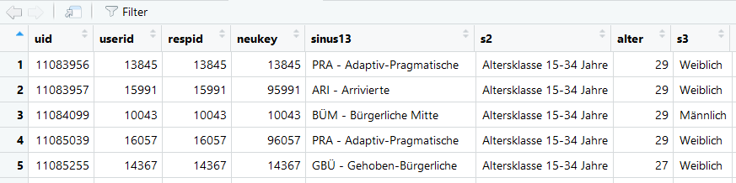
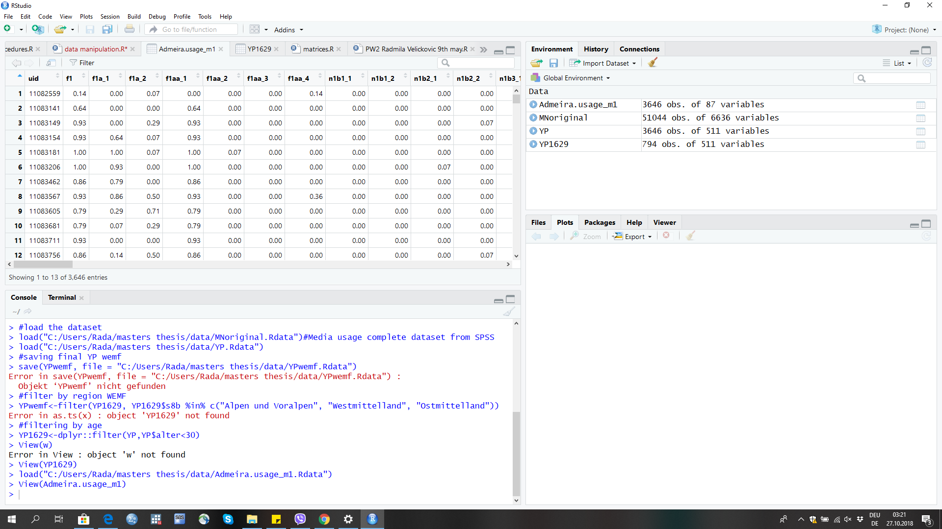
Example 1:media usage and general consumption data sets linkage
Straightforward merging
merge(x,y, by=”uid”)
Typical settings when different surveys are used in a panel
But quality checks needed:
e.g.duplicates
DEMOGRAPHIC/SOCIO-ECONOMIC/ATTITUDE/BEHAVIOURAL DATA
Media usage

Slide 7
Example 2: FastLink package
Implements a Fellegi-Sunter probabilistic record linkage model that allows for missing data and the inclusion of auxiliary information.
Expectation Maximization algorithm
The package implements methods described in Enamorado, Fiﬁeld, and Imai (2017): ''Using a Probabilistic Model to Assist Merging of Large-scale Administrative Records''

Slide 8
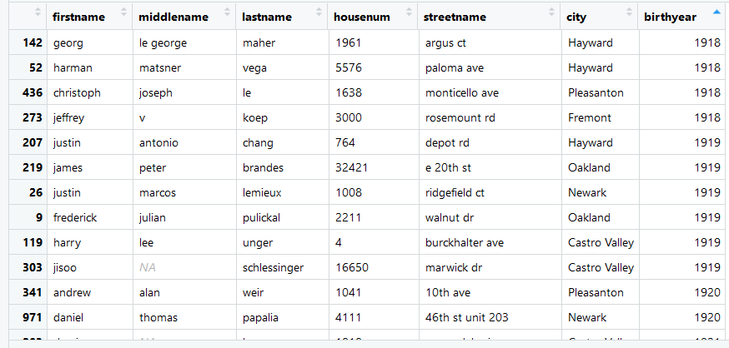
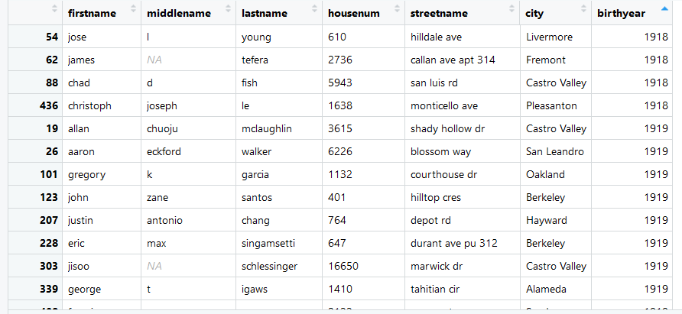
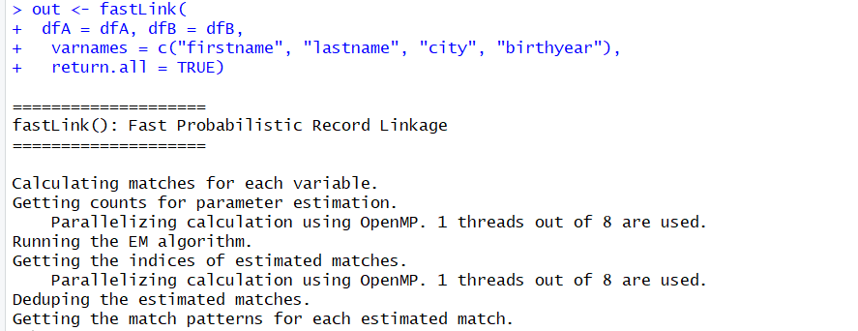
Example 2: FastLink package

Slide 9
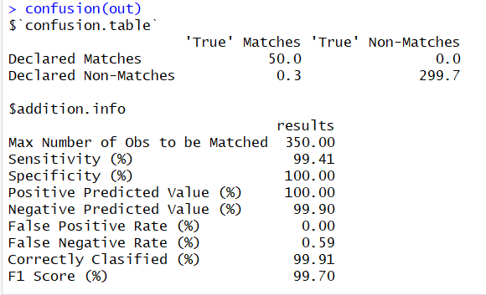
Example 2: FastLink package
Many other options exist:
1) Calculate agreement variable by variable:
gammapar*()
2) Count unique agreement patterns: tableCounts()
3) Calculate Fellegi-Sunter weights: emlinkMARmov()
4) Find the matches: matchesLink()
5) Dedupe the matches: dedupeMatches()

Slide 10
Example 3: PPRL (in what follows all the credits and many thanks to Prof. Dr. Rainer Schnell (Duisburg-Essen University) for providing the material from BigSurv18 conference)
PPRL enables new opportunities to link data that would otherwise not be available for research purposes.
Encrypted Statistical Linkage Keys (ESLs) and the use of Bloom filters
Efficient for large scale data

Slide 11
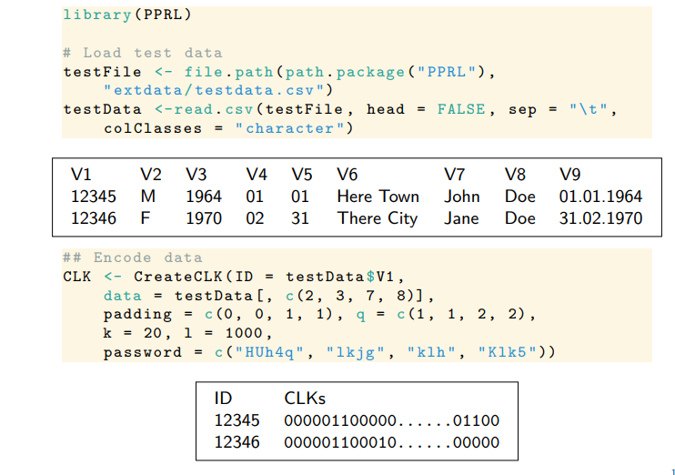
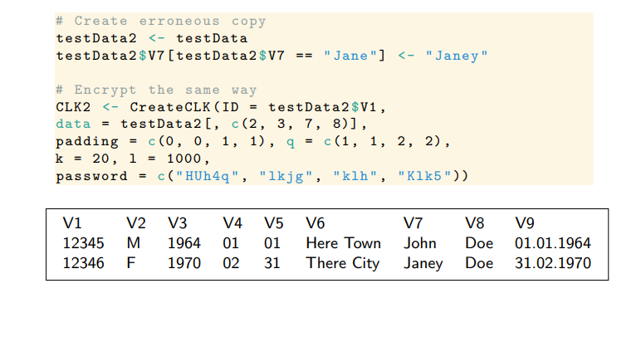
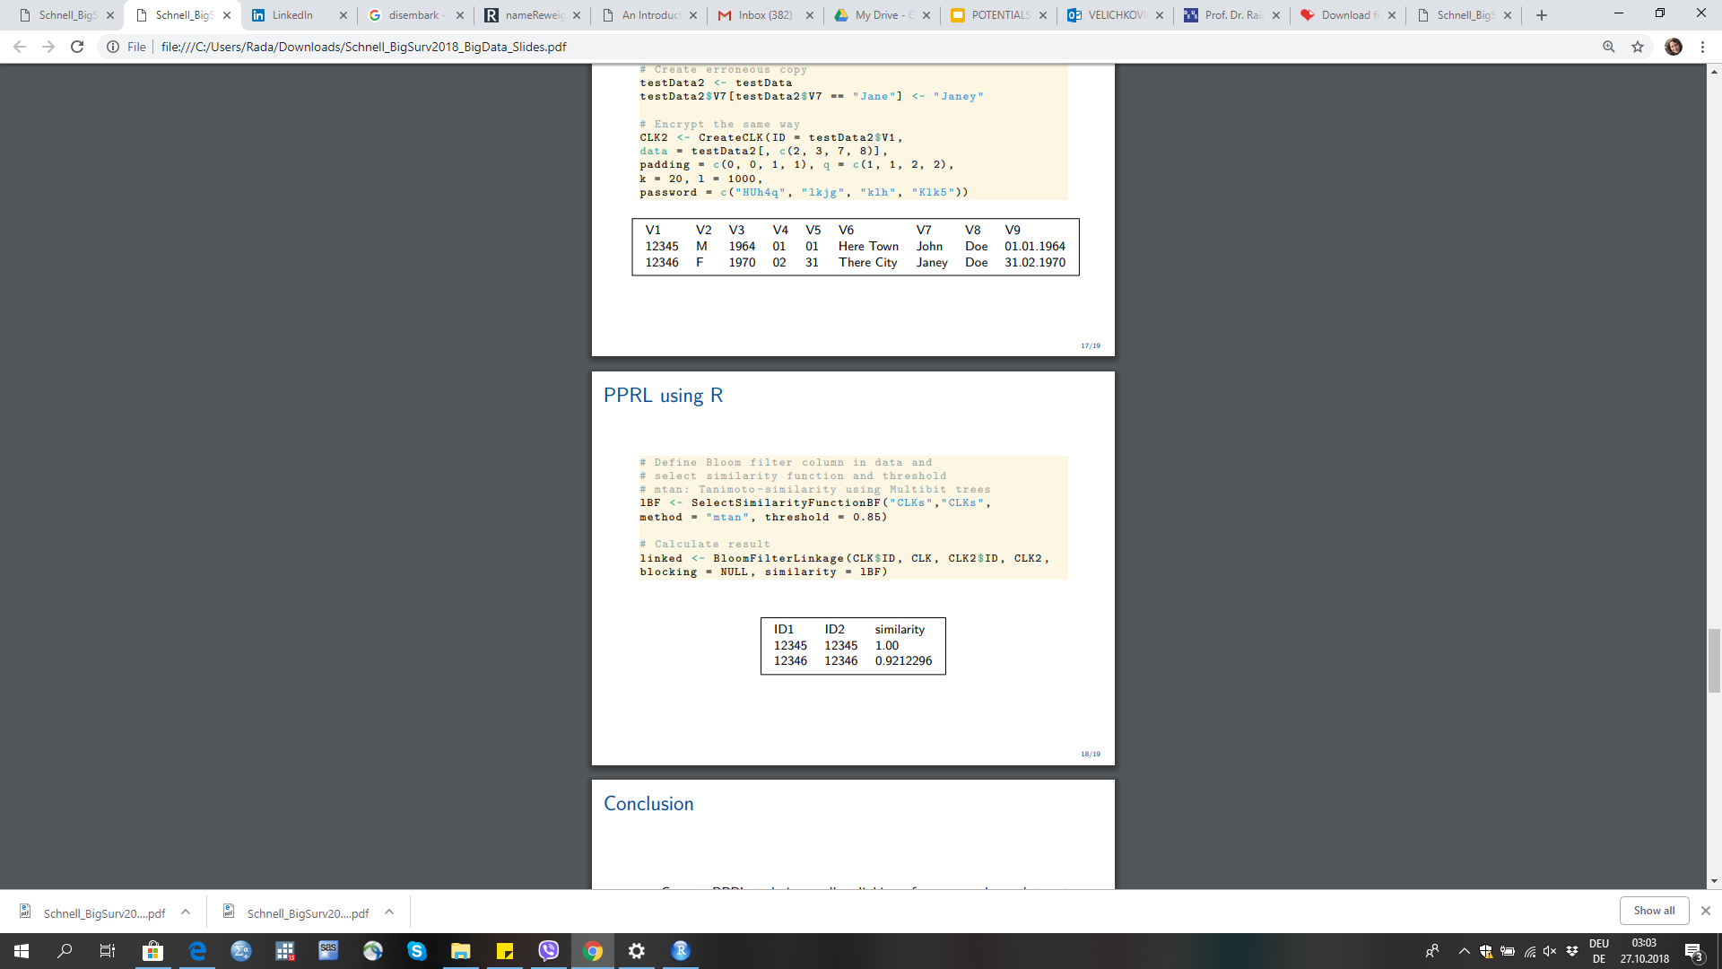
PPRL using R
By Prof. Dr. Rainer Schnell (Duisburg-Essen University); BigSurv18 conference, Barcelona

Slide 12
References and further readings
Package fastLink; Fast Probabilistic Record Linkage with Missing Data
Package RecordLinkage
The RecordLinkage Package: Detecting Errors in Data;
Package PPRL
Schnell, Rainer (2015): „Privacy Preserving Record Linkage“. In: Methodological Developments in Data Linkage. Hrsg. von Katie Harron/Harvey Goldstein/Chris Dibben. Chichester: Wiley: 201–225.
The RecordLinkage Package: Detecting Errors in Data;

